Slide 1
DVWA Setup Lab

Slide 2
DVWA Setup Lab
In this lab, you are going to setup the DVWA so you can run attacks on the website
Materials needed
Kali Linux Virtual Machine
Windows 7 Virtual Machine
Software Tools used
XAMPP

Slide 3
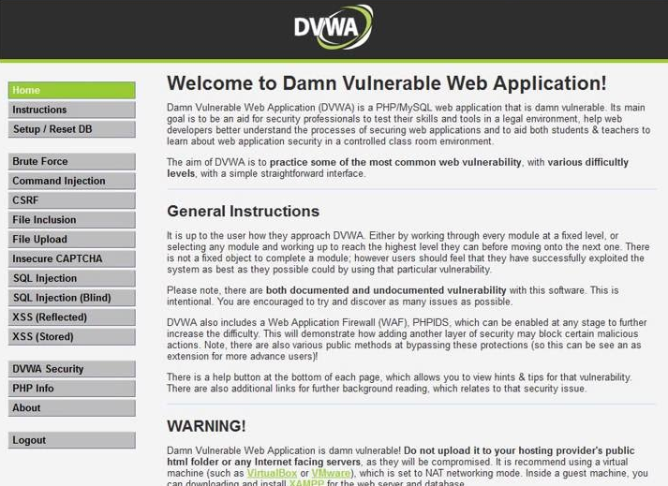
What is the DVWA?
The DVWA (Damn Vulnerable Web Application) is a website used for testing vulnerabilities on a website
It is freely available at http://www.dvwa.co.uk
Notes:
Bank: Chase
Username: jsmith17 Password: @pp13s33d

Slide 4
The DVWA Setup Lab
Setup the VM Environments
Download XAMPP
Install XAMPP
Download DVWA
Setup DVWA
Access DVWA

Slide 5
Setup Environments
Log into your range
Open the Kali Linux and Windows 7 Environments
You should be on your Kali Linux Desktop
You should also be on your Windows 7 Desktop

Slide 6
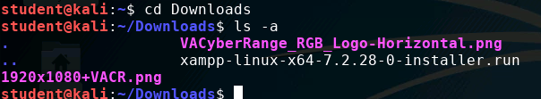
Download XAMPP
In Kali, open up a web browser and navigate to the following website:
www.apachefriends.org/download.html
Download the latest version of XAMPP for Linux, then close the browser when done
When prompted, click to save the file (It should save to your Downloads folder)
Open the Terminal and navigate to the Downloads folder:
cd Downloads
Verify the file was downloaded:
ls -a
XAMPP Installer!

Slide 7
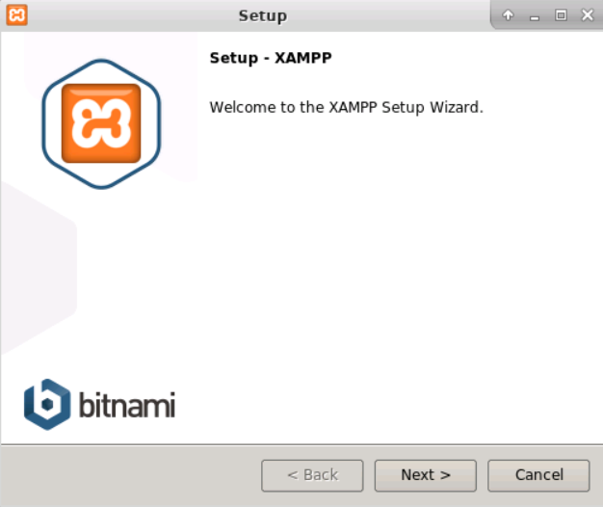
Install XAMPP
In the Downloads folder, set the executable permission:
chmod +x xampp-linux-x64-#.#.##-0-installer.run
Run the installer:
sudo ./xampp-linux-x64-#.#.##-0-installer.run
This opens the Setup Wizard for XAMPP

Slide 8
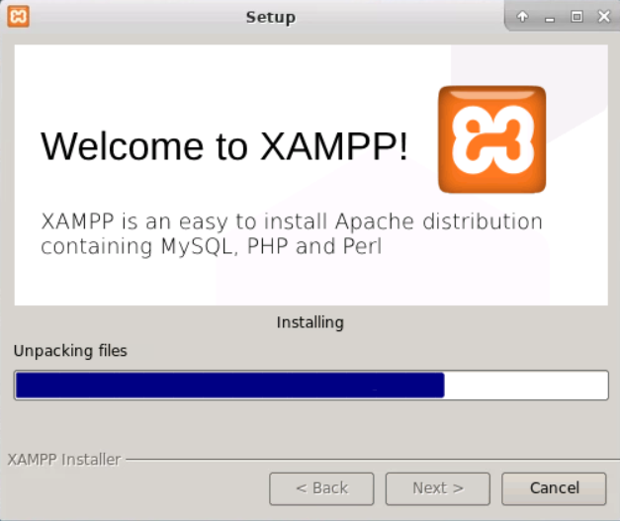
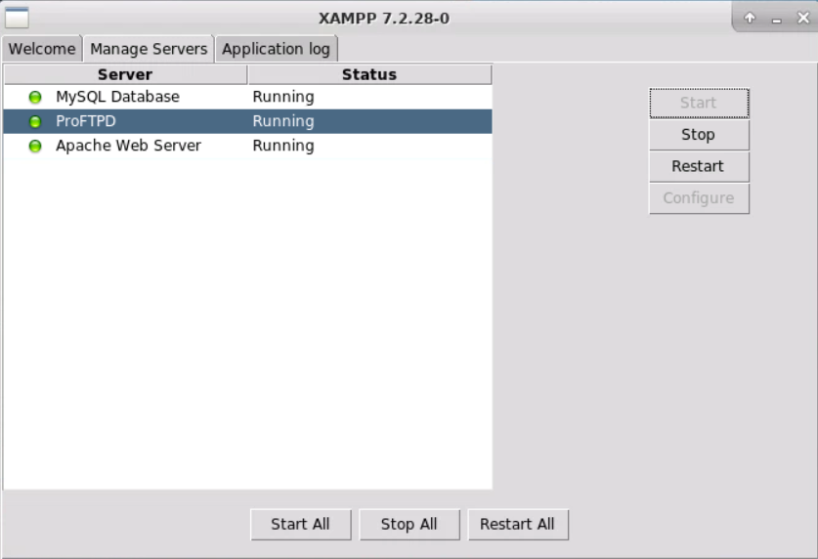
Install XAMPP
Run the installation
This will take some time (~5 minutes)
XAMPP is installed at /opt/lampp
When finished, XAMPP should open*
Open the Manage Servers tab
Ensure all three servers are running
[MySQL, ProFTPd, and apache]
You may have to manually start some servers
Start Servers
3 servers running
*The following command will start XAMPP
sudo /opt/lampp/./manager-linux-x64.run

Slide 9
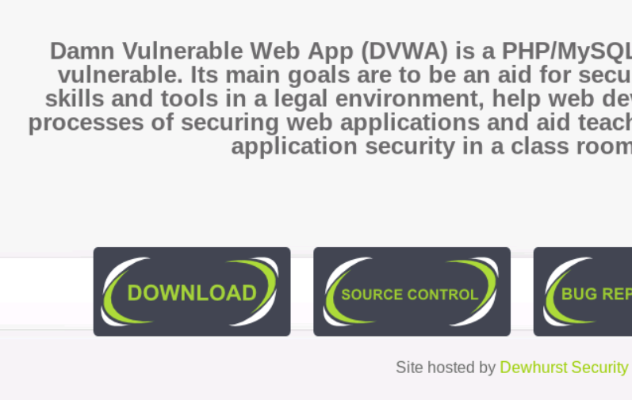
Download DVWA
Open a web browser and navigate to the following website:
www.dvwa.co.uk
Scroll down and select the “Download” option
When prompted, click to Save File (It should save to your Downloads folder)
Close the web browser
Open Terminal and navigate to the Downloads folder:
cd Downloads
Verify the file was downloaded:
ls -a
You should see a DVWA-master.zip file
To Download DVWA

Slide 10
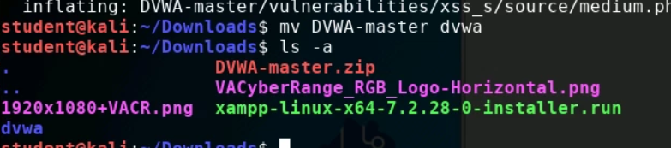
Setup DVWA
Unzip the DVWA-master.zip file:
unzip DVWA-master.zip
Rename the folder:
mv DVWA-master dvwa
Verify the name change:
ls -a
The folder should show as dvwa
Folder named ‘dvwa’

Slide 11
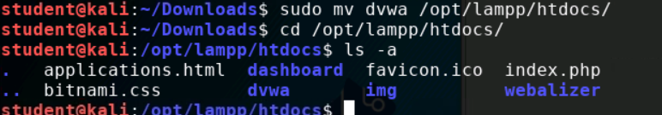
Setup DVWA
Move the file to the XAMPP HTML folder:
sudo mv dvwa /opt/lampp/htdocs
Navigate to this folder:
cd /opt/lampp/htdocs
Verify the file was moved:
ls -a
Navigate into the config folder:
cd dvwa/config

Slide 12
Setup DVWA
List all the files:
ls -a (Notice the config.inc.php.dist file)
Open the config file in a text editor:
nano config.inc.php.dist
Make sure the ‘db_user’ is set as root:
$_DVWA[ 'db_user' ] = 'root’;
Remove the database password:
Change 'p@ssw0rd' to ' ' (no space in between)
Save the changes and exit the text editor
(CTRL+X in nano, Y to save changes and exit.)

Slide 13
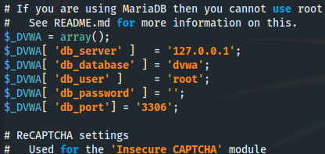
Setup DVWA
db_user is set as ‘root’
Password is removed

Slide 14
Setup DVWA
Make a new config file and remove the .dist from the name:
cp config.inc.php.dist config.inc.php
Verify the file was copied
ls -a
Exit Terminal
exit or CTRL+D

Slide 15
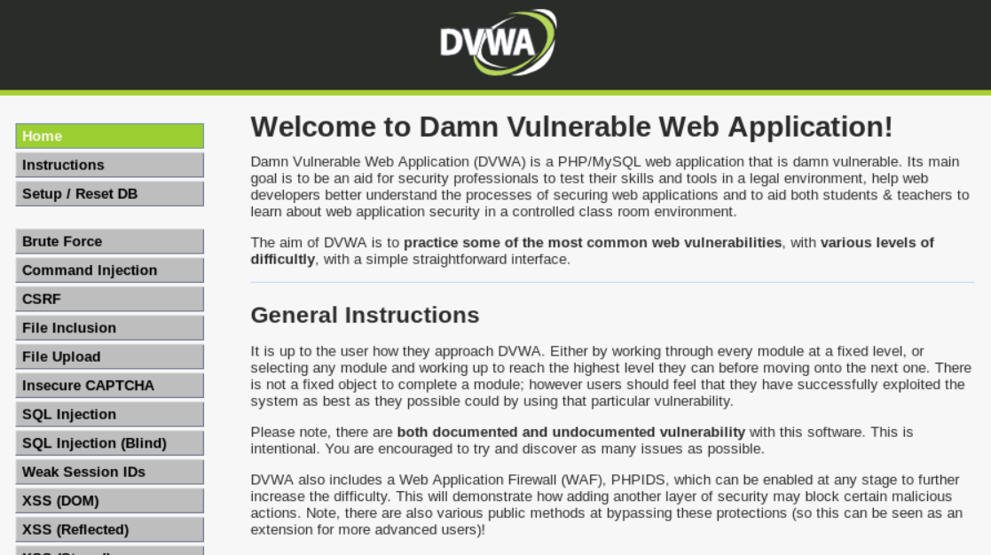
DVWA (In Kali)
Open a web browser
Navigate to the following URL:
http://127.0.0.1/dvwa
Scroll to the bottom of the page
Select the “Create/Reset Database” (this may take a few seconds)
Once the login screen appears, login
Username: admin
Password: password

Slide 16
DVWA (In Windows)
In the Windows VM, open Chrome
Navigate to the following URL:
http://Kali_IP_address/dvwa
(Using the Kali VM’s IP Address)
Login credentials are admin/password
If you need Kali’s IP Address, enter the following into Kali’s Terminal:
host kali.example.com

